Slide 1
DAMG 6210 - Data Management and Database Design
Roommate and Accommodation Management System
Group Number 9
Adarsh Suryavanshi - 002894722
Ashwatha E. S - 002308776
Pratik Kanade - 002311591
Priyank Bagad - 002338822
Sarthak Sargar - 002057385

Slide 2
Project Overview
ROOM & MATES is a modern web application oriented to change the one-sided paradigm of how people search for a place to live and find compatible roommates.
Designed with diversity in mind, it makes searching for housing options and cohabitants that fit your preferences both easy and fast.
The system is designed to especially meet challenges faced by people moving to new cities or regions, be it international students, young professionals, or people moving for work or education.
ROOM & MATES seeks to fill that gap by connecting users with resources and people who will make their transition easier and more convenient.
The system includes important features such as tailored matchmaking from user inputs, through which user preferences—-budget, location, lifestyle, and personality traits—are taken into consideration.
This new approach eases logistical issues while simultaneously building a sense of community building and exchange of culture.
Whether student or professional, adventurer or dreamer, ROOM & MATES secures your start within just the right home-away-from-home environment.

Slide 3
Purpose
The primary purpose of ROOM & MATES is to revolutionize and upgrade the process of finding accommodation and preferred roommates by :
1. Simplifying the search process for both rooms and compatible cohabitants.
2. Reducing the time and effort required to find suitable living arrangements for available locations.
3. Finding accommodation with preferable roommates with each student's chosen filters.
4. Providing a secure and reliable platform for all aspects of the room search and roommate-matching process.
5. Ultimately, creating a more efficient, reliable and user-friendly solution to address the challenges of finding housing in desired locations and building connections in new environments.

Slide 4
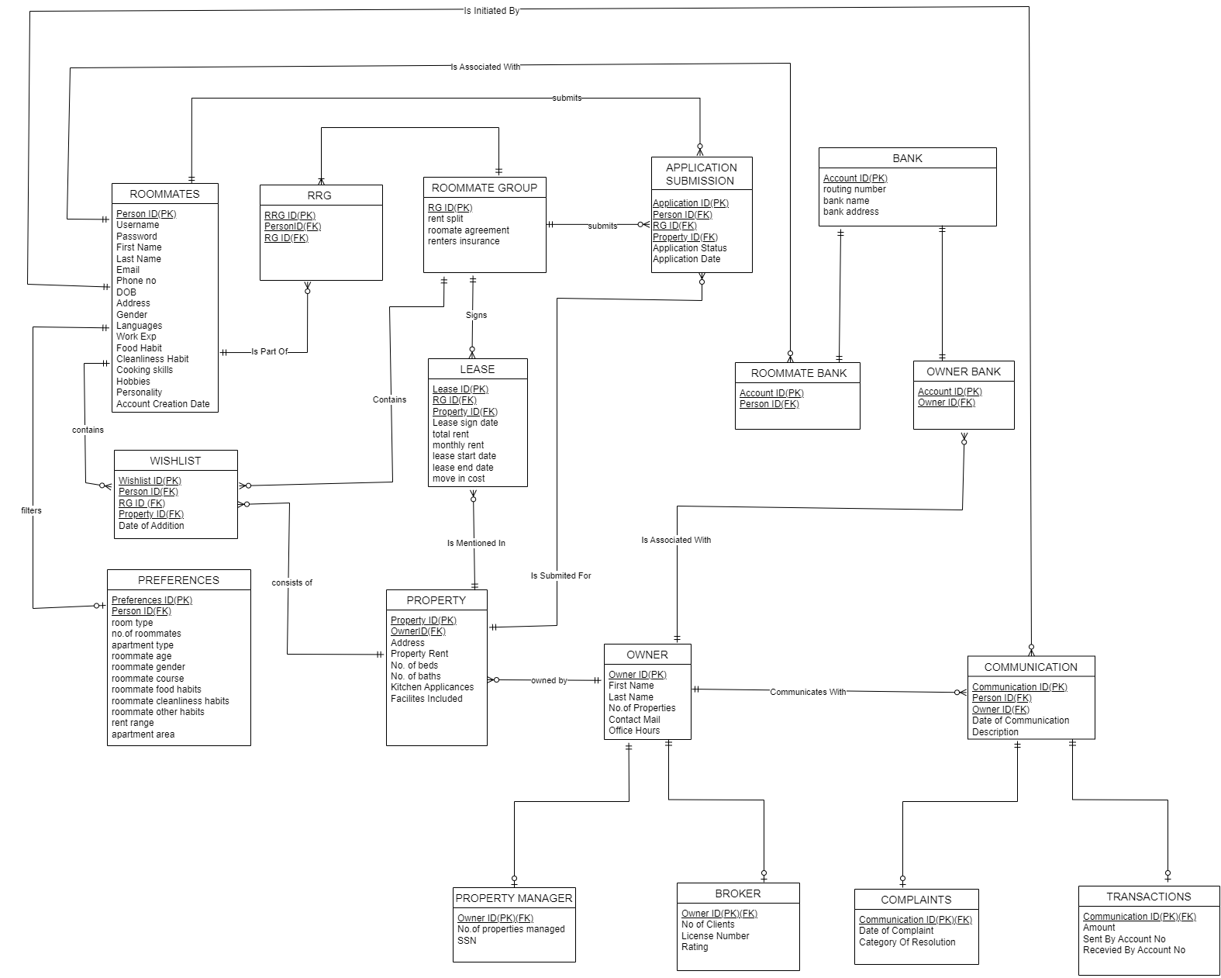
Entity - Relationship Diagram

Slide 5
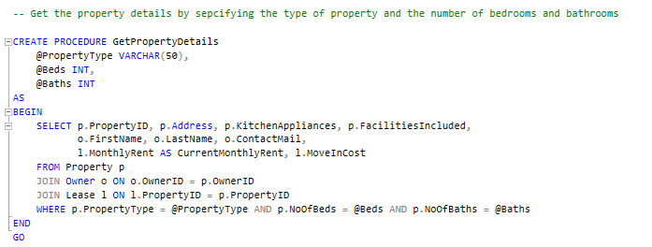
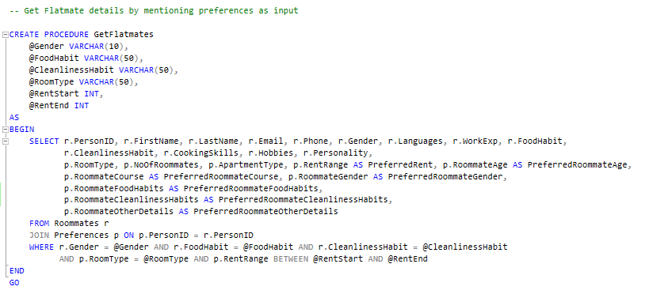
Stored Procedures

Slide 6
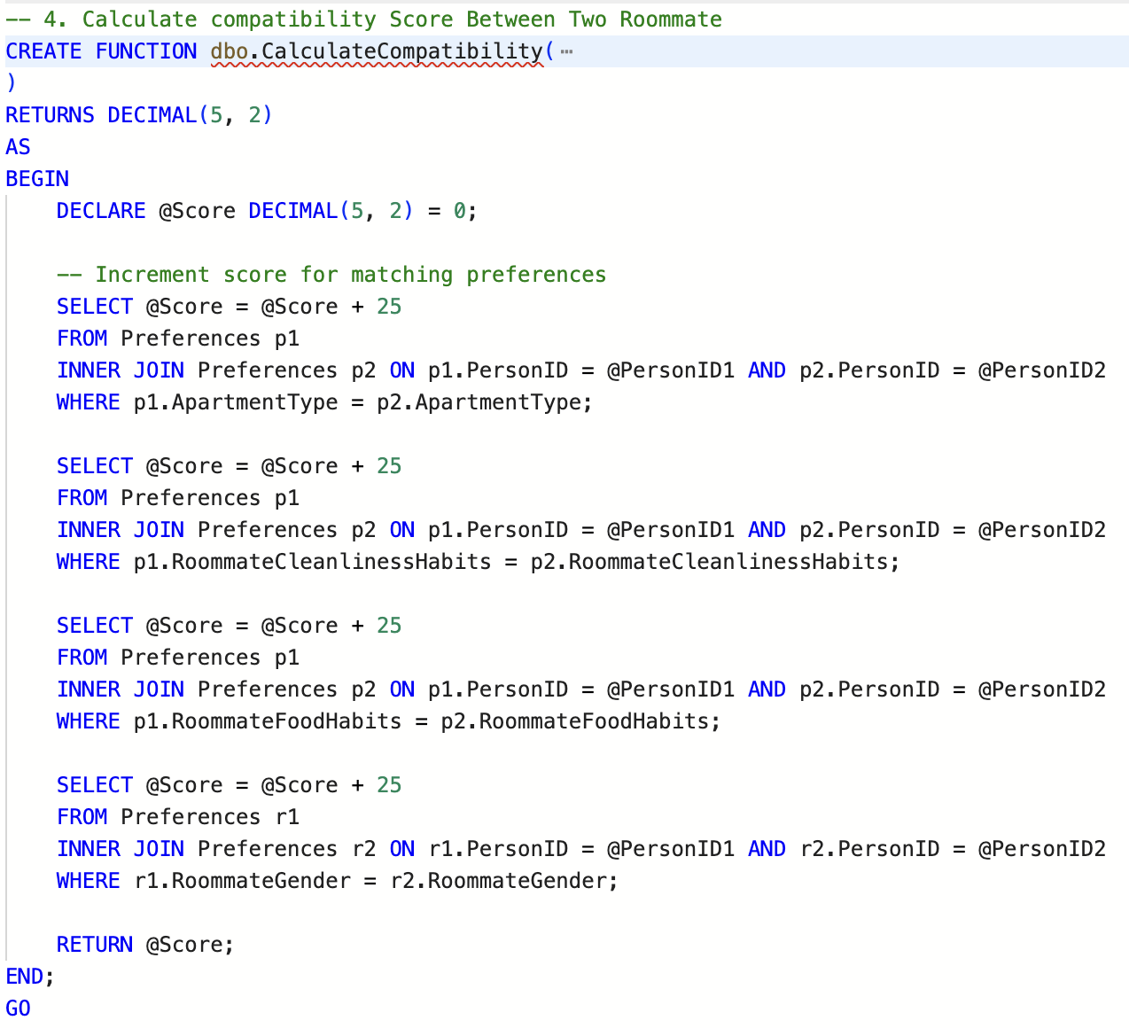
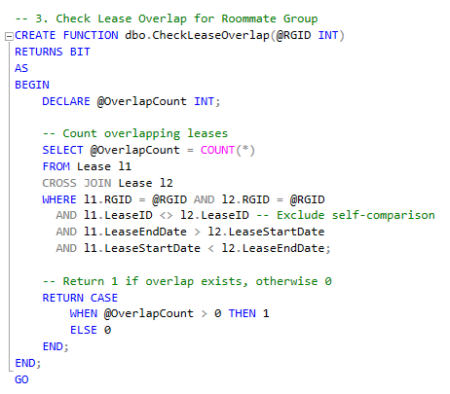
User Defined Functions

Slide 7
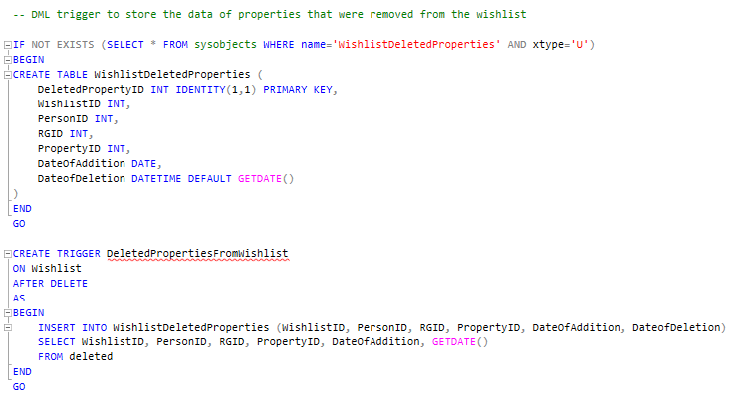
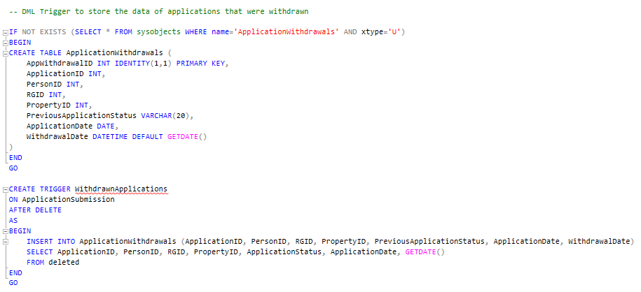
DML Triggers

Slide 8
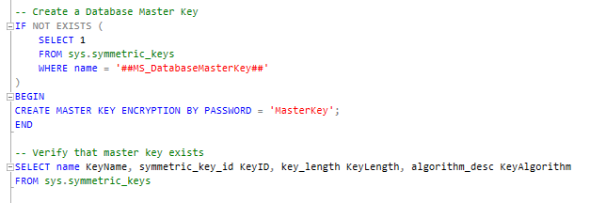
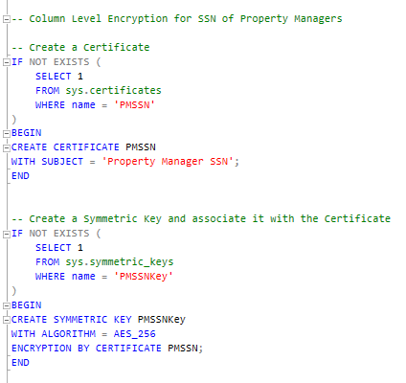
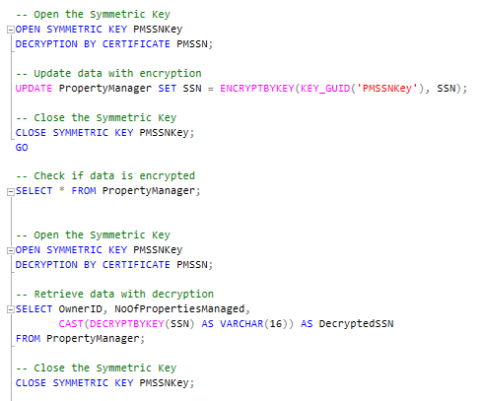
Data Encryption

Slide 9
Non Clustered Index
A non-clustered index is a database structure that improves search speed by creating a separate, logically ordered list of key values with pointers to the actual data rows. It doesn’t alter the physical order of the table’s data and is useful for queries involving WHERE, JOIN, or ORDER BY operations.

Slide 10
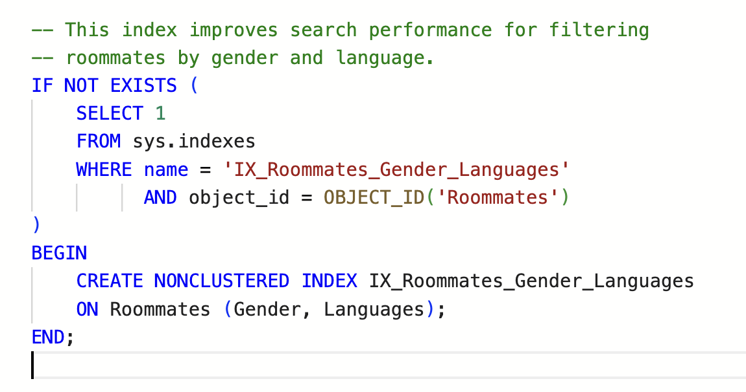
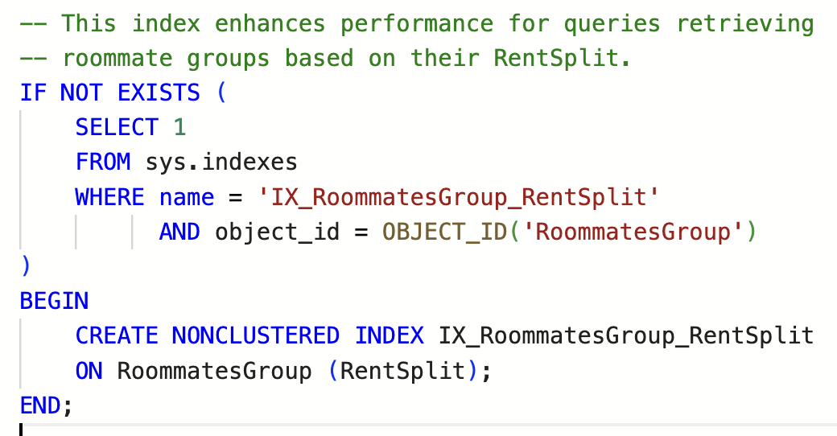
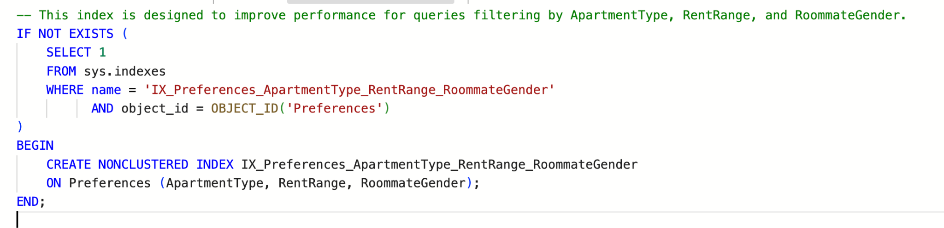
Non Clustered Index

Slide 11
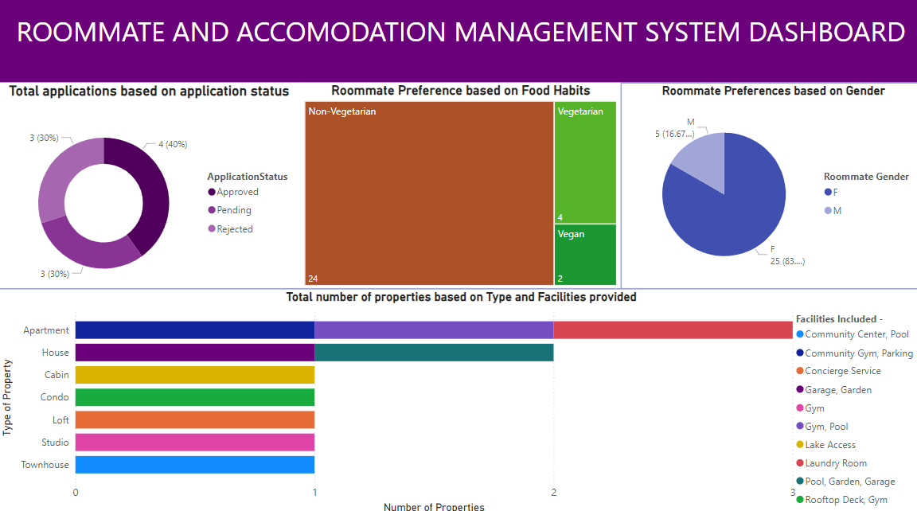
Power BI Report

Slide 12
LIVE DEMO

Slide 13
Conclusion
In conclusion, ROOM & MATES is more than a web application—it is a transformative solution designed to make finding the perfect accommodation and compatible roommates seamless, personalized, and stress-free.
By addressing the challenges faced by individuals, particularly those relocating to new regions, it fosters a sense of security, convenience, and community.
With its user-centric design, innovative features, and focus on enhancing the housing search experience, ROOM & MATES empowers users to build not just a living space, but a home. It’s the ideal companion for modern living in an increasingly connected world.

Slide 14
Thank You

